Slide 1


DSA03-Natural Language Processsing
SIMATS ENGINEERING
SAVEETHA INSTITUTE OF MEDICAL AND TECHNICAL SCIENCES
Capstone project presentation
Design and Development of an NLP-Based Multilingual Voice-Enabled Billing System for Micro-Retail Stores
Presented by:
Lokeshwara H-192325120
T S Sai Lahari-192325137
Balivada Ramya Sri-192324262
S.Dhanashree-192325082
Guided By Kumaragurubarar T

Slide 2
ABSTRACT
Micro-retail stores require fast, accurate and accessible billing systems, but conventional POS applications depend heavily on manual product search, keyboard input and touchscreen interaction. This creates difficulties when retailers handle multiple transactions simultaneously or interact using regional languages and informal speech. The proposed system is a multilingual voice-enabled billing platform that allows retailers to perform billing operations using natural spoken commands in multiple languages. The system combines Automatic Speech Recognition (ASR), multilingual Natural Language Processing, language identification, intent classification, Named Entity Recognition (NER), semantic product matching, contextual dialogue management and natural-language generation.
The proposed system extends NLP beyond billing by enabling multilingual inventory queries, natural-language transaction corrections, invoice interaction and sales analytics, providing an intelligent conversational assistant specifically designed for micro-retail environments.

Slide 3
INTRODUCTION
Micro-retail stores require quick and low-complexity billing operations.
Conventional POS systems primarily depend on manual interaction.
Retailers may naturally communicate using regional languages, English or code-mixed language.
Product names may be spoken using abbreviations, colloquial terms or pronunciation variations.
A simple speech-to-text system cannot understand the meaning and intent of retail commands.
Retailer Speech
↓
Language Identification
↓
Multilingual Speech Recognition
↓
NLP / NLU
↓
Intent + Entity Extraction
↓
Context & Semantic Resolution
↓
Billing / Inventory / Analytics
↓
Natural-Language Response

Slide 4
OBJECTIVES
To develop a multilingual NLP-based voice billing system that understands natural spoken retail commands and converts them into accurate, context-aware billing transactions.

Slide 5
PROBLEM STATEMENT
Traditional billing systems create several limitations:
Heavy dependence on keyboard/touchscreen input.
Manual product searching increases transaction time.
Most systems are designed around English-centric interfaces.
Regional-language speech is difficult to process.
Code-mixed speech is common in real-world retail environments.
Product names may have multiple spoken variations.
Speech-to-text alone does not understand transaction intent.
Ambiguous commands may result in incorrect product selection.
Sales and inventory information generally requires navigating dashboards.

Slide 6
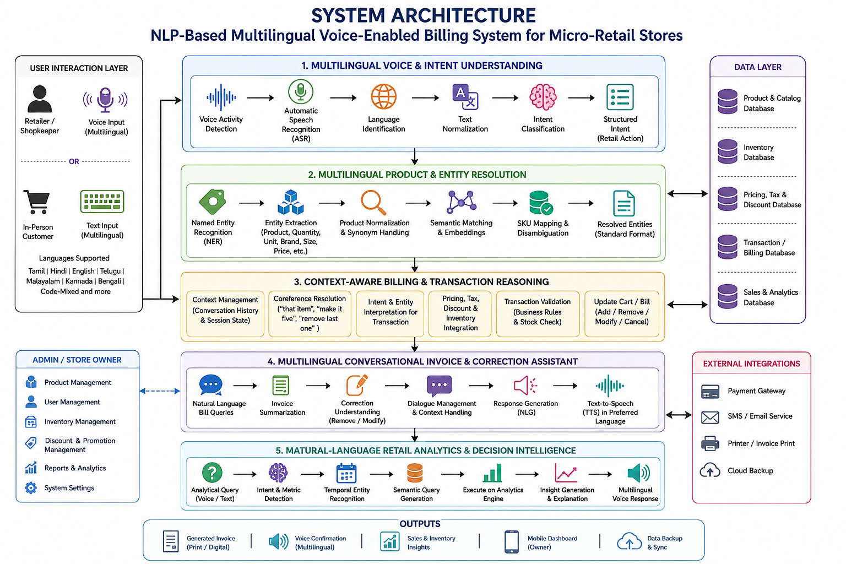
System Architecture

Slide 7
Modules
Module 1
Multilingual Voice & Intent Understanding
Module 2
Multilingual Product & Entity Resolution
Module 3
Context-Aware Billing & Transaction Reasoning
Module 4
Multilingual Conversational Invoice & Correction Assistant
Module 5 Natural-Language Retail Analytics & Decision Intelligence

Slide 8
MODULE – 1 Multilingual Voice & Intent Understanding
Accepts voice input in multiple languages and code-mixed speech.
Performs Automatic Speech Recognition (ASR) to convert speech into text.
Identifies the spoken language automatically.
Normalizes regional, colloquial and informal expressions.
Uses NLP-based intent classification to identify the requested action.
Supports multiple intents within a single voice command.
Recognizes billing actions such as add, remove, modify, search, return and checkout.
Converts natural speech into a structured retail command.

Slide 9
MODULE – 2 Multilingual Product & Entity Resolution
Extracts product names, brands, quantities, units and product attributes using NER.
Handles product names spoken in different languages and transliterated forms.
Supports synonyms, abbreviations and colloquial product references.
Uses semantic similarity and embeddings to match spoken products with database SKUs.
Resolves ambiguous product names using context and product attributes.
Handles incomplete product references from follow-up commands.
Maps multilingual expressions to a standard product representation.
Reduces incorrect product selection during voice-based billing.

Slide 10
MODULE – 3 Context-Aware Billing & Transaction Reasoning
Converts NLP outputs into real-time billing operations.
Maintains conversation context across multiple voice commands.
Uses coreference resolution for expressions such as “make it five” or “remove that item.”
Interprets natural-language quantity and unit modifications.
Processes multi-item and sequential billing commands.
Integrates product price, tax, discount and inventory information.
Validates transactions before updating the bill.
Supports natural-language addition, deletion, modification and cancellation of items.

Slide 11
MODULE – 4 Multilingual Conversational Invoice & Correction Assistant
Provides two-way voice interaction between retailer and billing system.
Allows retailers to query the current bill using natural language.
Supports multilingual invoice summarization and confirmation.
Detects and executes conversational billing corrections.
Maintains context for follow-up statements and corrections.
Supports queries such as bill total, item quantity, price and invoice status.
Generates responses in the retailer's preferred language.
Uses Text-to-Speech (TTS) for voice-based responses.
Enables conversational interaction throughout the invoice and checkout process.

Slide 12
Module 5-Natural-Language Retail Analytics & Decision Intelligence
Allows retailers to query sales and inventory data using natural language or voice.
Identifies analytics intent, metrics, products and temporal expressions.
Converts natural-language questions into structured database queries.
Supports queries such as:
“What are today's total sales?”
“Which product sold the most this week?”
Performs sales trend and product-performance analysis.
Generates concise natural-language explanations of business results.
Provides multilingual voice responses for analytical queries,Creates an AI-driven conversational decision-support layer for retailers.

Slide 13
Conclusion
Developed a multilingual, voice-enabled billing system using advanced NLP techniques for micro-retail stores.
Enables retailers to perform billing operations through natural spoken commands in multiple languages and code-mixed speech.
Integrates ASR, language identification, intent classification, NER, semantic matching and contextual understanding.
Supports context-aware product identification, billing modifications, invoice queries and conversational corrections.
Provides natural-language sales, inventory and business analytics through voice or text.
Reduces manual data entry, improves billing efficiency and provides a more accessible and intelligent POS experience.

Slide 14


